Slide 1

Stop Writing Java Start Writing Groovy
Evgeny Goldin

Slide 2
Java => Groovy

Slide 3

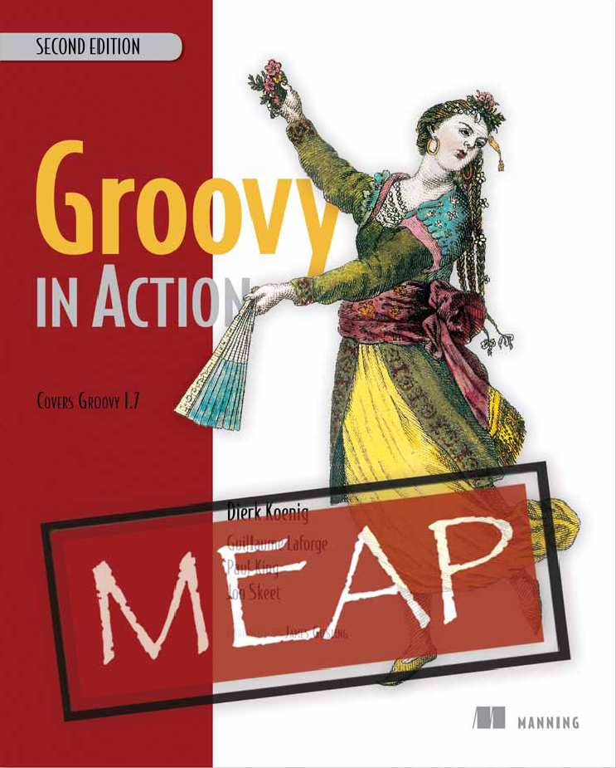

Slide 4

equals vs. ==

Slide 5
Groovy runs Java .. except where it doesn’t.
equals() / ==
== / is()
Works with nulls
assert null == null
assert null.is( null )
assert null.equals( null )

Slide 6
Cleanups

Slide 7
Lose public
Lose ; and return
Lose .class
Lose getX() / setX()

Slide 8
Lose public
Lose ; and return
Lose .class
Lose getX() / setX()
public String className( Class c ) { return c.getName(); }
o.setName( className( Map.class ));

Slide 9
Lose public
Lose ; and return
Lose .class
Lose getX() / setX()
def className( Class c ) { c.name }
o.name = className( Map )

Slide 10


Lose public
Lose ; and return
Lose .class
Lose getX() / setX()
http://codenarc.sourceforge.net/
http://plugins.intellij.net/plugin/?idea&id=5925

Slide 11
Lose public
Lose ; and return
Lose .class
Lose getX() / setX()
def className( Class c ) { c.name }
o.name = className( Map )
It is a big deal at the end of the day

Slide 12
def j = 4

Slide 13
def j = 4
def list = []
def list = [1, 2, 3, 4]

Slide 14
def j = 4
def list = []
def list = [1, 2, 3, 4]
def map = [:]
def map = [1:2, 3:4]

Slide 15
def j = 4
def list = []
def list = [1, 2, 3, 4]
def map = [:]
def map = [1:2, 3:4]
def array = [1, 2, 3, 4] as int[]

Slide 16
def j = 4
def list = []
def list = [1, 2, 3, 4]
def map = [:]
def map = [1:2, 3:4]
def array = [1, 2, 3, 4] as int[]
new Thread({ print j } as Runnable).start()

Slide 17
Safe navigation

Slide 18
Groovy Truth

Slide 19
if (( o != null ) && ( o.size() > 0 )) { .. }

Slide 20
if (( o != null ) && ( o.size() > 0 )) { .. }
if ( o?.size()) { .. }

Slide 21
if (( o != null ) && ( o.size() > 0 )) { .. }
if ( o?.size()) { .. }
Safe navigation operator : object?.method()

Slide 22
if (( o != null ) && ( o.size() > 0 )) { .. }
if ( o?.size()) { .. }
Safe navigation operator : object?.method()
Groovy Truth:
null is false
Empty String, Map or Collection is false
Zero number is false
if ( list ), if ( string ), if ( map ), if ( o?.size()) ..

Slide 23
But

Slide 24
assert “false”

Slide 25
assert “false”
assert “ “

Slide 26
assert “false”
assert “ “
Object.asBoolean()

Slide 27
assert “false”
assert “ “
Object.asBoolean()
Object => Boolean?
Groovy : o as boolean
Java : Boolean.valueOf( String.valueOf( o ))

Slide 28
assert “false”
assert “ “
Object.asBoolean()
Object => Boolean?
Groovy : o as boolean
Java : Boolean.valueOf( String.valueOf( o ))
“false”, “null”: false in Java, true in Groovy

Slide 29
assert “false”
assert “ “
Object.asBoolean()
Object => Boolean?
Groovy : o as boolean
Java : Boolean.valueOf( String.valueOf( o ))
“false”, “null”: false in Java, true in Groovy
Always specify if you use Java or Groovy Truth

Slide 30
assert “false”
assert “ “
Object.asBoolean()
Object => Boolean?
Groovy : o as boolean
Java : Boolean.valueOf( String.valueOf( o ))
“false”, “null”: false in Java, true in Groovy
Always specify if you use Java or Groovy Truth

Slide 31
Elvis Operator

Slide 32
int j = ( o.size() > 0 ) ? o.size() : -1;

Slide 33
int j = ( o.size() > 0 ) ? o.size() : -1
def j = ( o.size() ?: -1 )

Slide 34
int j = ( o.size() > 0 ) ? o.size() : -1
def j = ( o.size() ?: -1 )
Elvis operator: def j = value ?: defaultValue
Takes defaultValue if value evaluates to false

Slide 35
int j = ( o.size() > 0 ) ? o.size() : -1
def j = ( o.size() ?: -1 )
Elvis operator: def j = value ?: defaultValue
Takes defaultValue if value evaluates to false
Be careful with zero values and empty Strings

Slide 36
int j = ( o.size() > 0 ) ? o.size() : -1
def j = ( o.size() ?: -1 )
Elvis operator: def j = value ?: defaultValue
Takes defaultValue if value evaluates to false
Be careful with zero values and empty Strings
int j = ( size != null ) ? size : -1
int j = size ?: -1

Slide 37
int j = ( o.size() > 0 ) ? o.size() : -1
def j = ( o.size() ?: -1 )
Elvis operator: def j = value ?: defaultValue
Takes defaultValue if value evaluates to false
Be careful with zero values and empty Strings
int j = ( size != null ) ? size : -1 // Accepts zero size
int j = size ?: -1 // Doesn’t accept zero size

Slide 38
Default parameters

Slide 39
public String foo( int j, int k ){ …}
public String foo( int j ){ foo ( j, 1 ); }
public String foo(){ foo ( 1, 1 ); }

Slide 40
public String foo( int j, int k ){ …}
public String foo( int j ){ foo ( j, 1 ); }
public String foo(){ foo ( 1, 1 ); }
Overload

Slide 41
public String foo( int j, int k ){ …}
public String foo( int j ){ foo ( j, 1 ); }
public String foo(){ foo ( 1, 1 ); }
def foo ( int j = 1, int k = 1 ) { .. }

Slide 42
public String foo( int j, int k ){ …}
public String foo( int j ){ foo ( j, 1 ); }
public String foo(){ foo ( 1, 1 ); }
def foo ( int j = 1, int k = 1 ) { .. }
def foo ( int j = 1, int k ) { .. }

Slide 43
public String foo( int j, int k ){ …}
public String foo( int j ){ foo ( j, 1 ); }
public String foo(){ foo ( 1, 1 ); }
def foo ( int j = 1, int k = 1 ) { .. }
def foo ( int j = 1, int k ) { .. }
def foo ( int j, int k = 1 ) { .. }

Slide 44
public String foo( int j, int k ){ …}
public String foo( int j ){ foo ( j, 1 ); }
public String foo(){ foo ( 1, 1 ); }
def foo ( int j = 1, int k = 1 ) { .. }
def foo ( int j = 1, int k ) { .. }
def foo ( int j, int k = 1 ) { .. }
def foo ( int j = f1(), int k = f2()) { .. }

Slide 45
Groovy Beans

Slide 46
public class Bean () {
private int j;
public int getJ(){ return this.j; }
public void setJ( int j ){ this.j = j; }
}

Slide 47
class Bean {
int j
}
def b = new Bean()
println ( b.j ) / println ( b.getJ())
b.j = 33 / b.setJ( 33 )
N Groovy beans can be kept in the same file

Slide 48
GStrings

Slide 49
def s = ‘aaaaaaa’

Slide 50
def s = ‘aaaaaaa’
def s = ’’’ aaaaaaaaa bbbbbbbb’’’

Slide 51
def s = ‘aaaaaaa’
def s = ’’’ aaaaaaaaa bbbbbbbb’’’
def s = “aaaaaaa”
def s = ””” aaaaaaaaa bbbbbbbb”””

Slide 52
def s = “aaaaaaa${b.j}”
def s = ””” aaaa${ o.something() + b.j }aaaaa bbbbbbbb”””

Slide 53
def s = “aaaaaaa${b.j}”
def s = ””” aaaa${ o.something() + b.j }aaaaa bbbbbbbb”””
log.info ( String.format( “ .. %s .. ”, val ))
log.info ( “ .. ${val} .. ” )

Slide 54
def s = “aaaaaaa${b.j}”
def s = ””” aaaa${ o.something() + b.j }aaaaa bbbbbbbb”””
assert "aaaaa".class == String
assert "${1+2}".class == org.codehaus.groovy.runtime.GStringImpl

Slide 55
assert

Slide 56
if ( o == null ) { throw new RuntimeException( “msg” ) }

Slide 57
if ( o == null ) { throw new RuntimeException( “msg” ) }
assert o, “msg”

Slide 58
if ( o == null ) { throw new RuntimeException( “msg” ) }
assert o, “msg”
assert ( o != null ), “msg”

Slide 59
if ( o == null ) { throw new RuntimeException( “msg” ) }
assert o, “msg”
assert ( o != null ), “msg”
assert o, \ “Long message”

Slide 60
if ( o == null ) { throw new RuntimeException( “msg” ) }
assert o, “msg”
assert ( o != null ), “msg”
assert o, \ “Long message”
assert false, “Fatal error”

Slide 61
if ( o == null ) { throw new RuntimeException( “msg” ) }
assert o, “msg”
assert ( o != null ), “msg”
assert o, \ “Long message”
assert false, “Fatal error”
Asserting code samples is a common practice

Slide 62
def j = [1, 2]
def k = [3, 4]
assert j[0] == k[0]

Slide 63
def j = [1, 2]
def k = [3, 4]
assert j[0] == k[0]
Assertion failed:
assert j[0] == k[0]
|| | ||
|1 | |3
| | [3, 4]
| false
[1, 2]

Slide 64
GDK

Slide 65
http://groovy.codehaus.org/groovy-jdk/
Java+++

Slide 66
http://groovy.codehaus.org/groovy-jdk/
Java+++
Object
String
File
Collection, Map, List, Set
InputStream, OutputStream
Reader, Writer

Slide 67
Object/Collection/Map
each()
any(), every()
find(), findAll(), grep()
join()
collect()
min(), max(), sum()
inject()

Slide 68
String
toURL()
execute()
eachLine()
padLeft(), padRight()
tr()

Slide 69
File
deleteDir()
eachLine()
eachFileRecurse()
getText()
write(String)
traverse()

Slide 70

Q&A

